Slide 1
designing for the Medical
Device market
CONFIDENTIAL: All contents copyright of Illinois Tool Works, Inc. (ITW).
The ITW Photonics Group, Cal Sensors, ITW Linx, Lumex and Opto Diode logos are registered trademarks of ITW, Inc. Copyright © 2013, all rights reserved.

Slide 2

Technology Trends in the Medical Device Industry
Today’s medical device industry is growing at a rapid pace. Some factors affecting that growth include:
  An increasing population of elderly (over 50% of the global population will reach the age of 65 or over by the year 2039);
  The need to contain costs, while simultaneously maintaining a high standard of care through technological innovation; and
  An increased demand for efficiencies (i.e. facilitating minimally invasive surgeries, ensuring faster turnaround of patients, home and self-monitoring devices, etc.)
Because of the their many benefits, the use of optoelectronics has also grown significantly to overcome design challenges in the medical device industry.
Lumex’s wide range of products and time-tested formula for design collaboration has consistently offered the best results for meeting the demands in the medical environment and the increasing complexity of product designs.
Lumex’s technical design engineers strive to assist in adding features, enhanced functionality and graphically rich user-interfaces to any product’s design.
Design Considerations for Medical Applications
Response Time
Portability
Low Power Consumption
Durability
Extreme Temperatures
Daylight Visibility
CONFIDENTIAL: All contents copyright of Illinois Tool Works, Inc. (ITW).
The ITW Photonics Group, Cal Sensors, ITW Linx, Lumex and Opto Diode logos are registered trademarks of ITW, Inc. Copyright © 2013, all rights reserved.

Slide 3
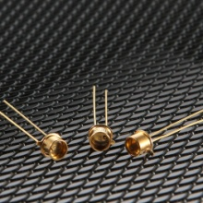
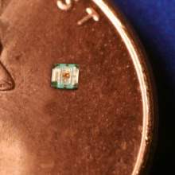
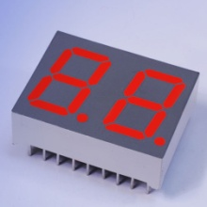
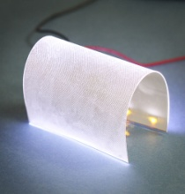
Product Components Ideal for Medical Device Applications
Ultraviolet (UV) LEDs
Available in 355nm, 365nm, 377nm, 385nm 405nm and 415nm wavelengths with 4-6mW power output and 2-watt High Power SMD
Longer lifespan; greater than 50,000 hours
TO-46 package, with glass lens in a through-hole format
Custom wavelengths are available
Lumex Product Families
High Power LEDs
Ultraviolet LEDs
Thru-Hole & SMD LEDs
Panel & PCB Indicators
LED Displays
LED Arrays
Light Pipes
Infrared Devices
Monochromatic & Color LCDs
0404 Surface-Mount RGB LEDs
Full color surface-mount RGB LED
0404 Packaging – 1.0mm x 1.00mm x 0.25mm
Low current operation (30/40/20 mcd respectively for RGB @ 2mA)
Operating temperature range from -40˚C to +85˚C
SMD & Thru-Hole High Temp LED Displays
Market-leading, operating temperatures up to 105˚C
Single & dual digit layouts available in standard stock
Triple or quad digit layouts available with no additional tooling
Industry 1st, Shapeable, Flexible LED Backlight!
Unique backlight can be shaped (i.e., to allow space for a switch or other component on the circuit board) without causing shadowing or a compromising light performance
Profile height of just 0.125mm (97% thinner than traditional backlights)
Specially designed ultra-thin surface, specifically designed for enhanced light distribution
CONFIDENTIAL: All contents copyright of Illinois Tool Works, Inc. (ITW).
The ITW Photonics Group, Cal Sensors, ITW Linx, Lumex and Opto Diode logos are registered trademarks of ITW, Inc. Copyright © 2013, all rights reserved.

Slide 4
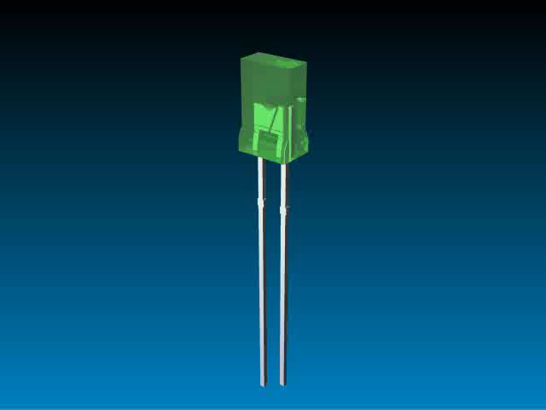
Multiple Technologies…
One Product Solution
In today’s competitive marketplace, many engineers are finding that many standard technologies do not meet all of their needs.
More and more, design engineers are recognizing that an application-specific solution will offer the best result for more complex design needs.
Lumex has proven success at translating initial design concepts and turning them into reality.
Whether addressing a current
design challenge or integrating
multiple components into one
sub-assembly, Lumex will work
with you from initial prototype
through final production.
Lumex offers experience,
quality and innovative originality
to help bring products to market
faster and help provide that
competitive edge.
Benefits of
Value Add Solutions
Focus on application needs
Stand out from competition
Enhanced reliability
Speed time to market
Reduced labor costs
Faster ROI
Full plug ‘n play solution
Engineering know-how that acts as an extension of your own team
CONFIDENTIAL: All contents copyright of Illinois Tool Works, Inc. (ITW).
The ITW Photonics Group, Cal Sensors, ITW Linx, Lumex and Opto Diode logos are registered trademarks of ITW, Inc. Copyright © 2013, all rights reserved.

